Slide 1

Environment Preparation
Setting up nodes & servers

Slide 2
Agenda
Introduction to Decisioning Services
Node Classification
Debugging the Services
Monitoring services
Pre-requisite Data
Lets do a recap

Slide 3
Environment Setup
Unlike a traditional BPM application development, CDH involves various services which are
responsible for enablement of various features.
These services need to be activated and configured before the application creation.
LSA & Decisioning / Marketing Architects work together to determine hardware and software estimates.

Slide 4
Environment Setup
Lets understand the process of decisioning services and various rules auto-generated required for smooth business flow.
Below are the CDH Services to be enabled on the nodes to make sure decisioning implementation has no issues.
ADM (Adaptive Decision Manager)
DDS (Decision Data Store)
Stream
RTDG (Real time Data Grid)
Realtime
Background Processing

Slide 5
Nodes & Clusters
Node | Cluster
A Node is nothing but a server/machine where the PEGA PRPC Instance has been installed. One can purchase multiple nodes .i e the servers to host the PRPC instances. By distributing PEGA among multiple nodes, one can achieve the load balancing. Ie balancing | Cluster is group of related nodes inter-connected together. Load Balancer is used to balance load among multiple servers which significantly improves the performance of application

Slide 6
Node Classification
Classifying the nodetypes to the nodes is called as node classification.
We cannot add new node in personal edition unless it is configured in windows.
Navigate to Admin Studio > Nodes
Inorder to classify a node type to a node
UNIVERSAL – All Services enabled.
MANUAL

Slide 7
Node Classification
Inorder to perform node classification in PEGA,
Perform below steps
PEGA Installation Directory > TOMCAT > BIN > SetEnv.BAT
Open It on Notepad
Add the parameters to –DNodeType as below

Slide 8
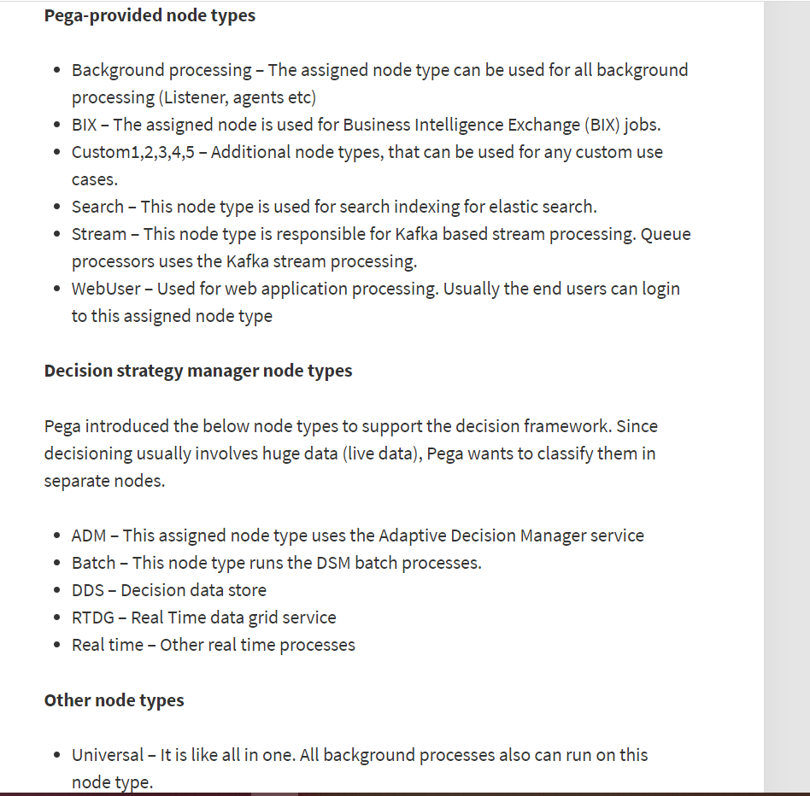
Node Classification
Update the parameters for DNodeType with required services.
Shut down the PEGA Server.
Restart the server
Navigate to Admin Studio & Verify the new services.

Slide 9
Verification
1. Verify from Admin Studio
Navigate to Admin Studio > Nodes > Click on Node
Ensure the decisioning service names are displayed .
2. Verify from Dev Studio
Navigate to Dev Studio > Configure > Decisioning > Infrastructure > Services
Verify the services have node enabled and pointed to node ip address & check if NORMAL

Slide 10
Context Dictionary

Slide 11
Context Dictionary
Context is the targeted audience to whom the promotions/marketing is made.
Primary Context – Primary audience or main audience targeted for marketing
Secondary Context – Secondary audience or alternate audience targeted for marketing.
At any given point of time, there can be only 1 primary audience & multiple secondary audience.
Associated data – Associated information of specified context for ex, products hold, services purchased etc.
Once the context dictionary is generated , a product rule is also included inorder to install the same dictionary in higher environments.

Slide 12
Customer Profile Viewer

Slide 13
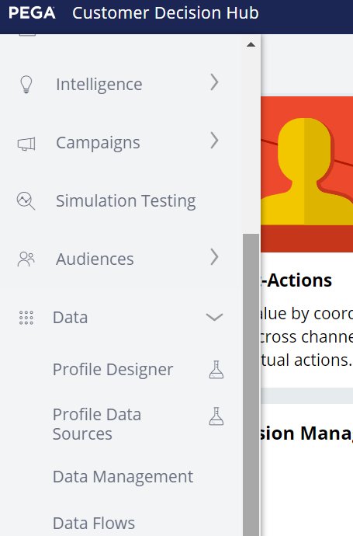
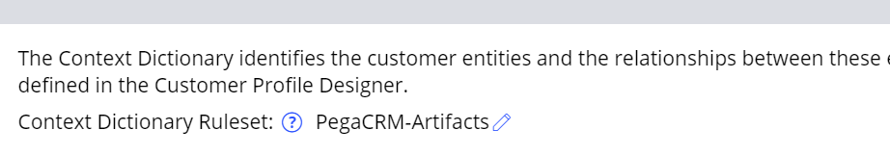
Customer Profile Viewer
Starting from PEGA 8.7 Customer data is stored as profiles under customer profile designer and we can add additional profiles etc Starting from 8.6 version,
All the associated data related to the context is now stored under customer profile designer.
Inorder to access the customer profile designer,
Navigate to customer decision hub > Data > Profile Designer

Slide 14
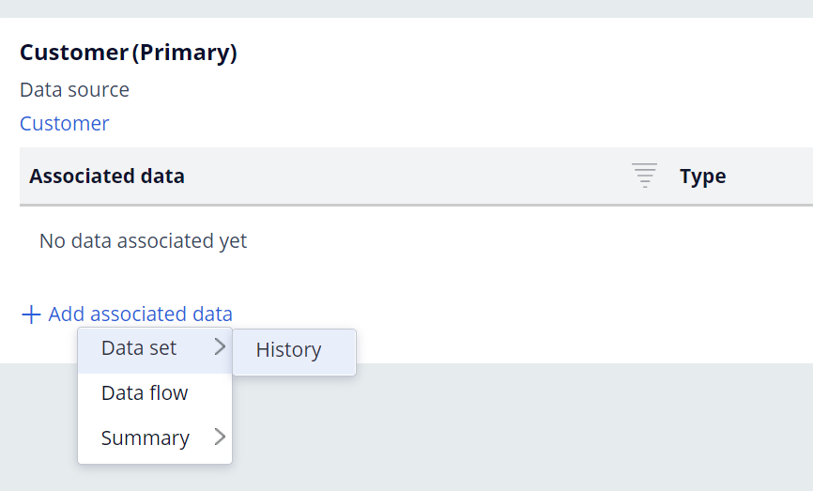
Customer Profile Viewer
We can add associated data directly for PRIMARY CONTEXT within the customer profile designer.
Click on Edit & Add Associated Data
We need to create an dataset (usually a database table data set) inorder to connect the associated data with a primary context.
Only the data sets that have a common column between primary context and associated data will be displayed in the drop down.

Slide 15
Differences between 8.7 , 8.8 & 23 & 24
PEGA 8.7 | PEGA 8.8 | PEGA 23 | PEGA 24
No Customer Journeys | No Customer Journeys | Customer Journeys | Customer Journeys
No AI Capabilities | No AI Capabilities | AI Capabilities added | AI Capabilities added
No Revision Manager/Ops Manager | No Revision Manager/ Ops Manager | Revision Manager/Ops Manager | Revision Manager/Ops Manager
No CDH Assistant | No CDH Assistant | CDH Assistant | CDH Assistant
Manual Application(CAR & NBAD Template) Installation | CDH Application Wizard | CDH Application Wizard & EnablementArtifacts:01-01 created | CDH Application Wizard & EnablementArtifacts:01-01 Rulesets
No Persona Management | No Persona Management | Persona Management | Persona Management
No Hot Offers & Clickstreams | No Hot Offers & clickstreams | Hot Offers & Product Associations & Clickstream | Hot Offers & Product Associations & Clickstream
No NBA Configurations | No NBA Configurations | NBA Configurations & Supporting Decisions | NBA Configurations & Supporting Decisions

